Slide 1
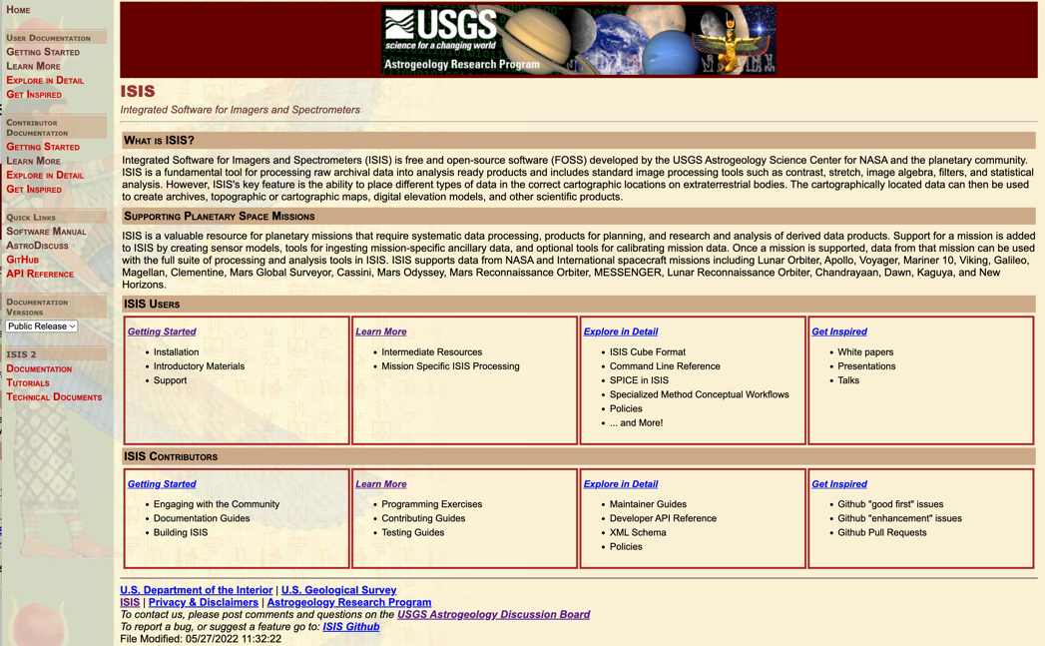
Lab 5 – Map Projection, Mosaics, Bundle Adjustments and other fun!
https://isis.astrogeology.usgs.gov

Slide 2
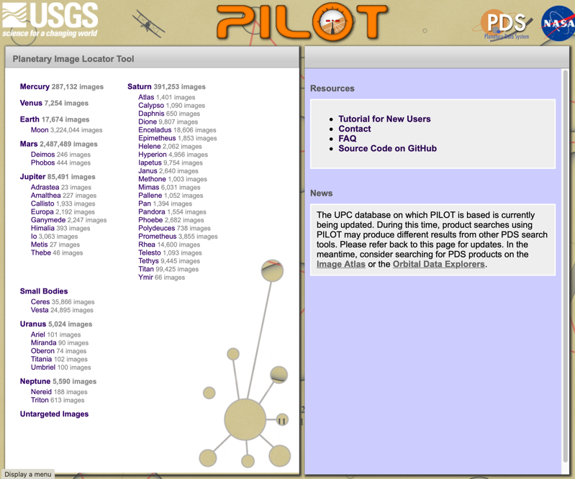
Find Data Using Pilot
https://pilot.wr.usgs.gov/index.php
Demo of Pilot Search
Talk about Map Projection On the Web (POW)

Slide 3
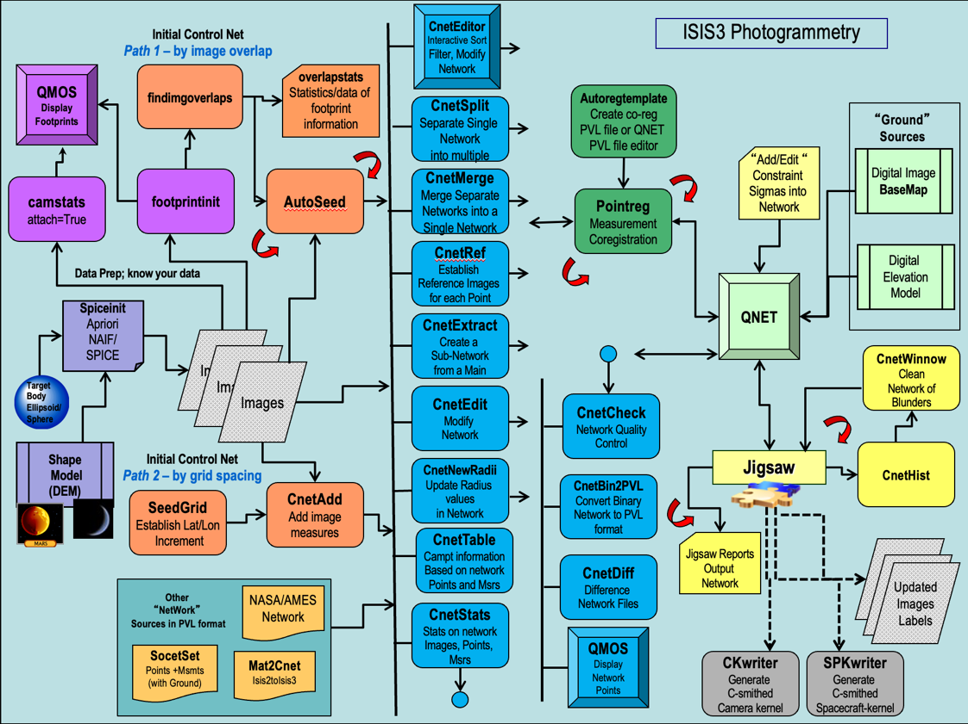
ISIS Photogrammetry can be complicated – we’ll keep it simple A more detailed USGS presentation is appended at the end of this file.

Slide 4
Uncontrolled Mosaic Example - Preparation
Use the directory MDIS_example
Demo: using lists in ISIS programs
Create Level 1 products
Inspect with qmos & qview
qview lev1.lis
qmos lev1.lis
### Prepare Directories
ls EDR/*.IMG | cut -d"/" -f2 | cut -d"." -f1 >! names.lis
mkdir Lev0
mkdir Lev1
mkdir Lev2
### Create level 0 cubes and add spice data to them
mdis2isis from=EDR/\$1.IMG to=Lev0/\$1.lev0.cub -batch=names.lis
spiceinit from=Lev0/\$1.lev0.cub -batch=names.lis web=yes url=https://astrogeology.usgs.gov/apis/ale/v0.9.1/spiceserver/
### Calibrate images and add footprint info
mdiscal from=Lev0/\$1.lev0.cub to=Lev1/\$1.lev1.cub -batch=names.lis
camstats from=Lev1/\$1.lev1.cub attach=true linc=10 sinc=10 -batch=names.lis
footprintinit from=Lev1/\$1.lev1.cub linc=10 sinc=10 maxemission=89 maxincidence=89 increaseprecision=true -batch=names.lis
ls Lev1/*.cub >! lev1.lis

Slide 5
Uncontrolled Mosaic Example – Map Projection
A single map projection template is needed…
For later mosaicking, all projected images need to utilize the same resolution, projection, longitude domain, latitude type etc…
Demo maptemplate
Examine sinu.map
Project images and Mosaic with different blending strategies
### Try a ‘quick’ map projection
cam2map from=Lev1/\$1.lev1.cub to=Lev2/\$1.lev2.cub map=sinu.map pixres=map -batchlist=names.lis
ls Lev2/*.cub >! lev2.lis
### Mosaic with different blending strategies
automos fromlist=lev2.lis mosaic=slapdash.cub matchbandbin=false priority=average
equalizer fromlist=lev2.lis process=both
ls Lev2/*equ.cub >! lev2.equ.lis
automos fromlist=lev2.equ.lis mosaic=equ_slapdash.cub matchbandbin=false priority=average
### USE QVIEW TO VIEW THE RESULT - note the seams and offsets
qview equ_slapdash.cub

Slide 6
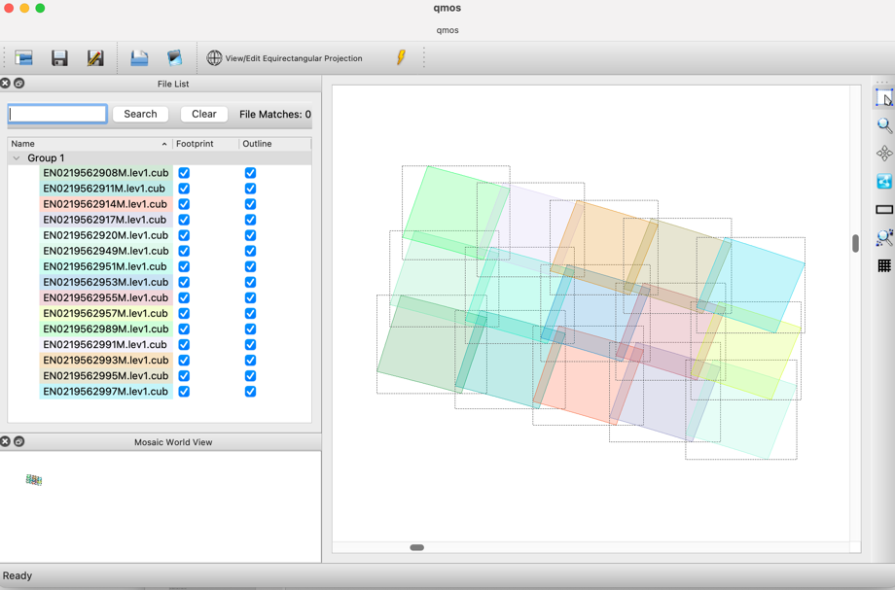
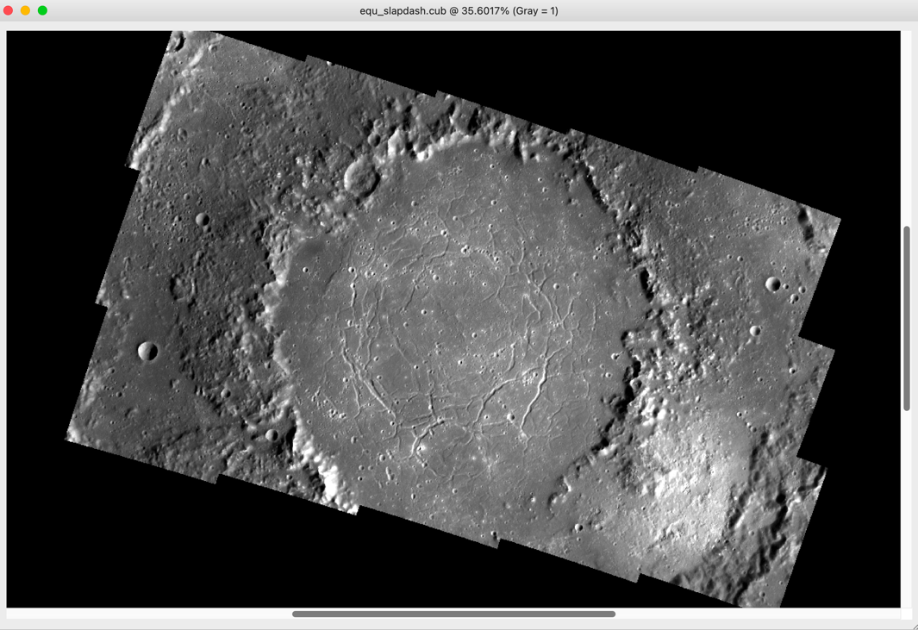
These MDIS data are very well-behaved
Uncontrolled mosaics work great

Slide 7
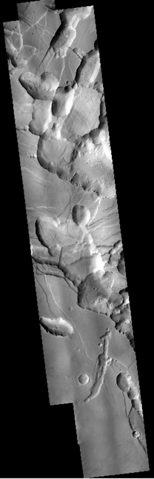
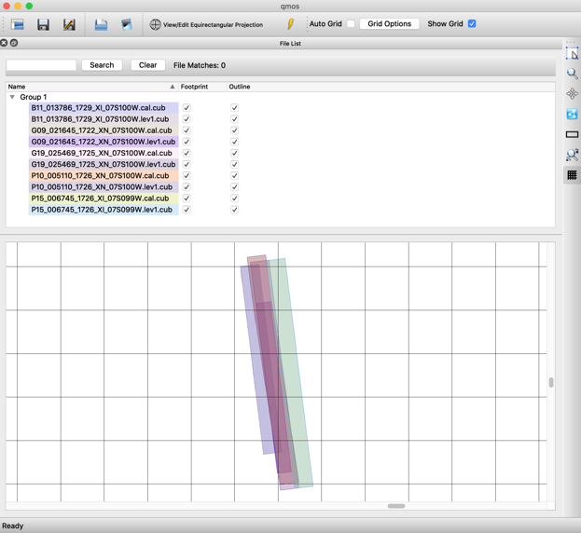
Uncontrolled Mosaic Example – 2nd example (if time allows)
Demo a repeat with CTX data – see LAB5_CTX_SCRATCH.txt

Slide 8
Controlled Mosaic Example
Based on a USGS tutorial using Messenger data
Use the MDIS_Controlled_example folder and steps in the LAB5_FULL_SCRATCH.txt file
Major Steps:
Find overlaps between images
Seed with Control points
Massage the Control Network
Use pointreg to refine control point positions
Use jigsaw to update the pointing kernels
Map Project and Mosaic the images.
Can be an iterative process with lots of human intervention

Slide 9
Pre-processing – Cleanup the data
Import the PDS files into the USGS ISIS software (bundled with ASP)
Add the SPICE info on spacecraft pointing and position (note we use the USGS SPICE web service – the URL changed recently and may change again in future ISIS releases)
Calibrate the images
### Prepare Directories
ls EDR/*.IMG | cut -d"/" -f2 | cut -d"." -f1 >! names.lis
mkdir Lev0
mkdir Lev1
mkdir Lev2
### Create level 0 cubes and add spice data to them
mdis2isis from=EDR/\$1.IMG to=Lev0/\$1.lev0.cub -batch=names.lis
spiceinit from=Lev0/\$1.lev0.cub -batch=names.lis web=yes url=https://astrogeology.usgs.gov/apis/ale/v0.9.1/spiceserver/
### Calibrate images and add footprint info
mdiscal from=Lev0/\$1.lev0.cub to=Lev1/\$1.lev1.cub -batch=names.lis
camstats from=Lev1/\$1.lev1.cub attach=true linc=10 sinc=10 -batch=names.lis
footprintinit from=Lev1/\$1.lev1.cub linc=10 sinc=10 maxemission=89 maxincidence=89 increaseprecision=true -batch=names.lis
ls Lev1/*.cub >! lev1.lis

Slide 10
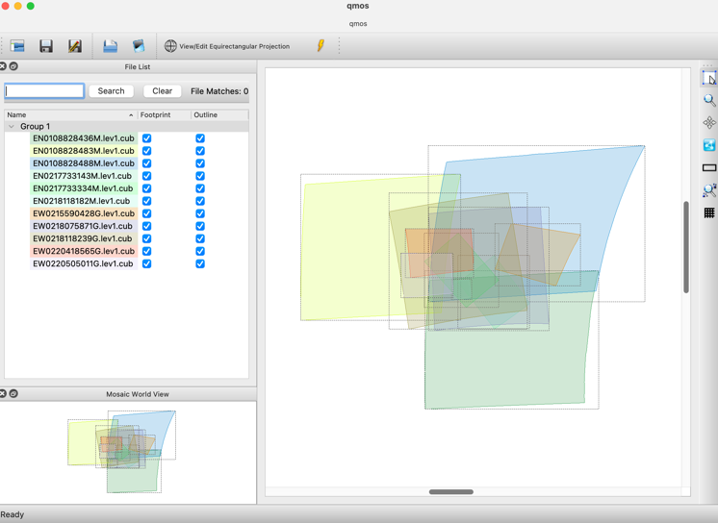
Check progress with:
qmos lev1.lis
Try a quick uncontrolled map projection and mosaic
### Try a ‘quick’ map projection
cam2map from=Lev1/\$1.lev1.cub to=Lev2/\$1.lev2.cub map=sinu.map pixres=map -batchlist=names.lis
ls Lev2/*.cub >! lev2.lis
### Mosaic with different blending strategies
automos fromlist=lev2.lis mosaic=slapdash.cub matchbandbin=false priority=average
equalizer fromlist=lev2.lis process=both
ls Lev2/*equ.cub >! lev2.equ.lis
automos fromlist=lev2.equ.lis mosaic=equ_slapdash.cub matchbandbin=false priority=average
### USE QVIEW TO VIEW THE RESULT - note the seams and offsets
qview equ_slapdash.cub
Not so hot…. But we can improve the outcome with control points

Slide 11
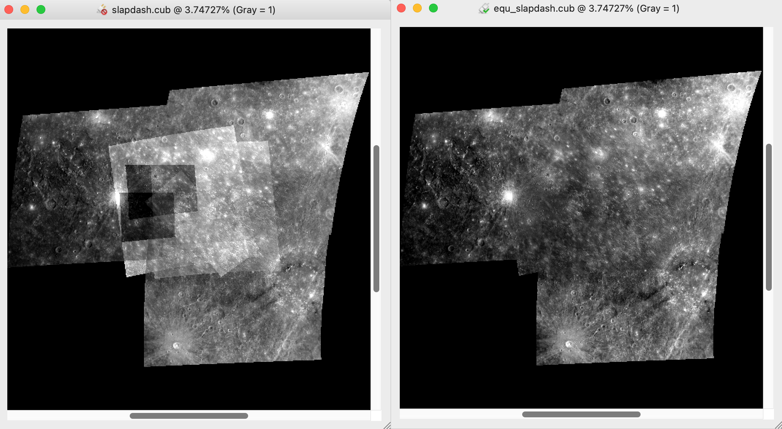
But equalization works well…. qview slapdash.cub equ_slapdash.cub

Slide 12
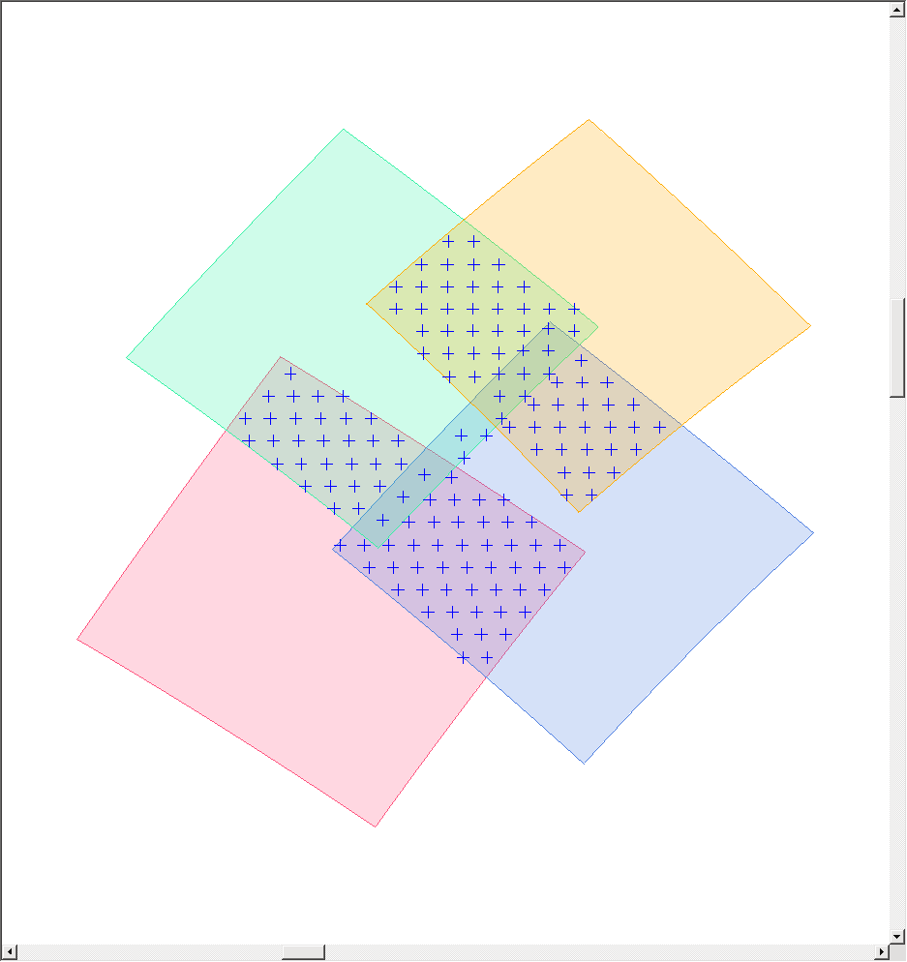
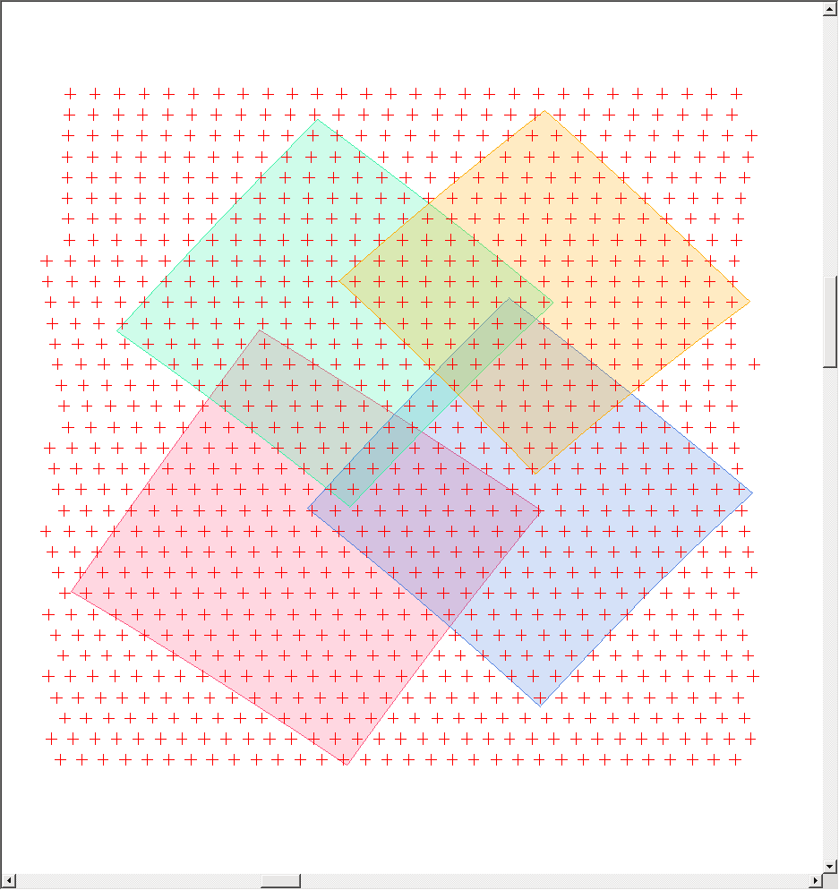
Pre-processing – Bundle Adjust
findimageoverlaps
autoseed – creates points based on your image overlaps
seedgrid – only knows about the lat/lon/spacing
cnetadd – adds the image list you’re using
cnetedit – downselects to the points that cover the images
Two possible strategies
We use this one
findimageoverlaps fromlist=lev1.lis overlaplist=overlaps.dat errors=ovl.err detailed=true
overlapstats fromlist=lev1.lis overlaplist=overlaps.dat
### Examine seed.def
autoseed fromlist=lev1.lis overlaplist=overlaps.dat deffile=seed.def onet=auto.net errors=auto.err pointid="mess_??" networkid=MESS description="Ptys551"

Slide 13
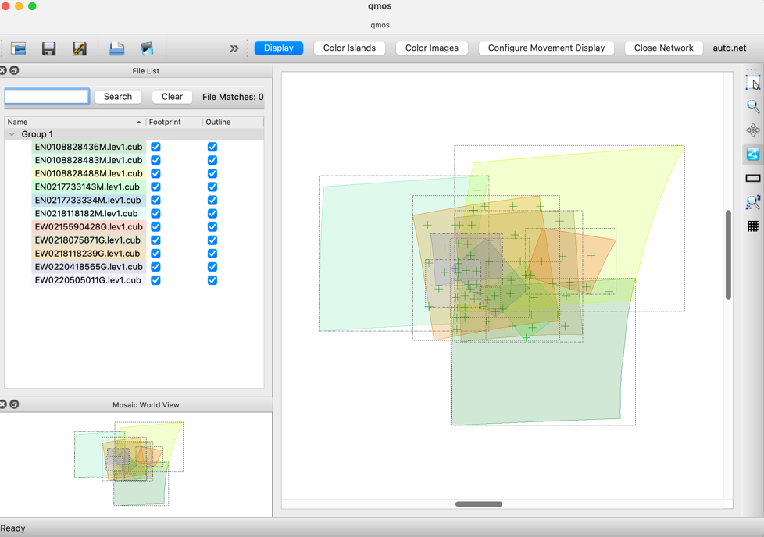
Check progress with:
qmos lev1.lis
### USE QMOS TO VIEW THE FOOTPRINTS + CONTROL NET
qmos lev1.lis
### Use qnet for additional info
qnet
### File->Open Control Net and Cube List->lev1.lis and then auto.net
### Triage the control network by eliminating useless points
### Examine validmsr.def
cnetref fromlist=lev1.lis cnet=auto.net onet=auto_ref.net log=auto_ref.log deffile=validmsr.def criteria=resolution type=mean
cnetedit cnet=auto_ref.net onet=auto_ref_edit.net

Slide 14
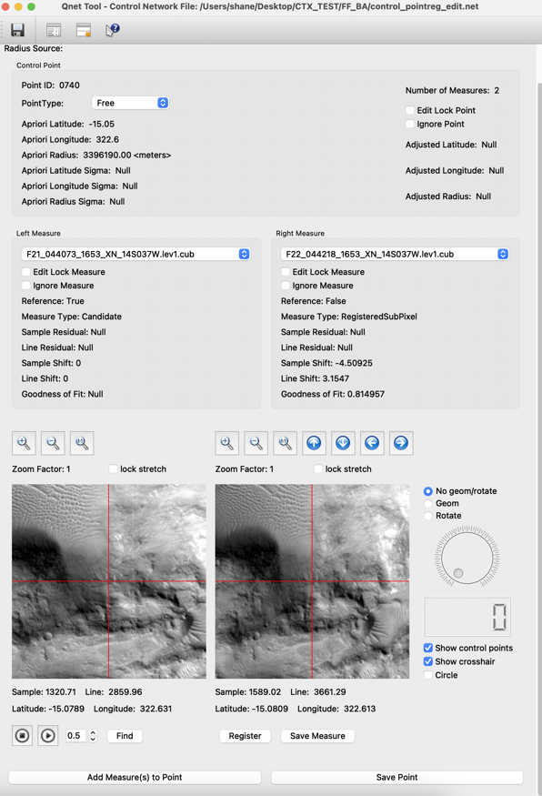
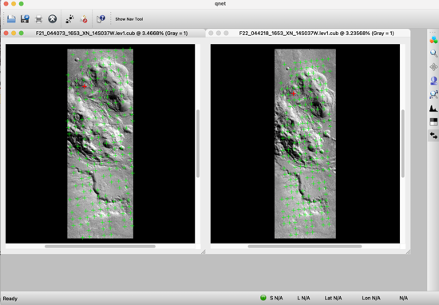
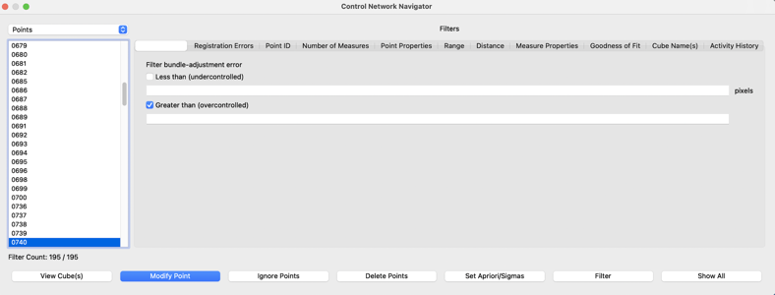
Pre-processing – Check the Control network with Qnet
Start qnet
File -> Open control network and cube list
Select lev1.lis and auto.net
Select the first control point listed in the ‘Control Network Navigator’ window. Click the ‘View Cube(s)’ button.
Click any of the points on the image display to open the Qnet tool.
(check the Geom button in the lower right when comparing images)
In the Qnet tool you can delete or modify points, blink-compare them etc…
Some networks are huge... The global MDIS mosaic control net has 12.5 million points

Slide 15
Pre-processing – pointreg
Object = AutoRegistration
Group = Algorithm
Name = MaximumCorrelation
Tolerance = 0.8
End_Group
Group = PatternChip
Samples = 31
Lines = 31
End_Group
Group = SearchChip
Samples = 101
Lines = 101
End_Group
Group = SurfaceModel
DistanceTolerance = 1.5
WindowSize = 7
End_Group
End_Object
End
Another def file (pointreg_P31x31_S101x101.def) describes how to do the pattern matching. e.g.
How large is the pattern?
How large is the search area?
How good a match is ok?
### Try all points with a tight search chip
pointreg fromlist=lev1.lis cnet=auto_ref_edit.net onet=auto_ref_edit_reg.net deffile=pointreg_P31x31_S101x101.def flatfile=auto_ref_edit_reg.txt points=all measures=all
### Try the failed points again with a wide search chip
pointreg fromlist=lev1.lis cnet=auto_ref_edit_reg.net onet=auto_ref_edit_reg2.net deffile=pointreg_P135x135_S200x200_gradient.def flatfile=auto_ref_edit_reg2.txt points=all measures=candidates
### Remove points that are total failures
cnetedit cnet=auto_ref_edit_reg2.net onet=auto_ref_edit_reg2_edit.net
### Quality checks on the control network
cnetcheck fromlist=lev1.lis cnet=auto_ref_edit_reg2_edit.net prefix=Chk_ tolerance=0.0
cnetstats fromlist=lev1.lis cnet=auto_ref_edit_reg2_edit.net create_image_stats=yes image_stats_file=ImgStats_auto_ref_edit_reg2_edit.csv create_point_stats=yes point_stats_file=PtStats_auto_ref_edit_reg2_edit.csv

Slide 16
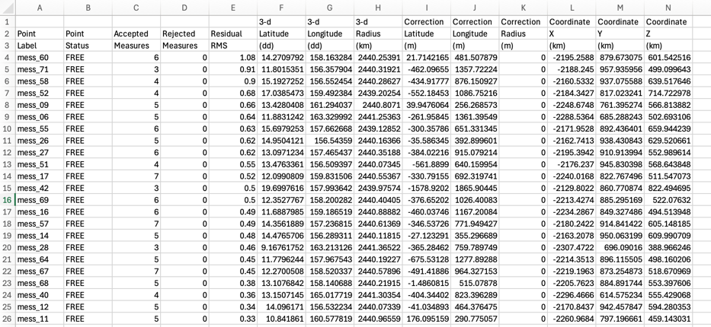
Jigsaw !!
We first run jigsaw as a dry-run i.e. no change to the image cubes
jigsaw fromlist=lev1.lis cnet=auto_ref_edit_reg2_edit.net onet=JigOut.net update=no radius=no errorpropagation=no outlier_rejection=no sigma0=1.0e-10 maxits=10 camsolve=angles twist=yes spsolve=no camera_angles_sigma=0.025
### Inspect for problems here. Remove bad (high residuals; see below) points in qnet if needed.
### Setup new directory for adjusted level 1 cubes and run jigsaw for realz
cp -R Lev1 Updated_Lev1
ls Updated_Lev1/*cub >! lev1_updated.lis
jigsaw fromlist=lev1_updated.lis cnet=auto_ref_edit_reg2_edit.net onet=JigOut.net update=yes radius=no errorpropagation=no outlier_rejection=no sigma0=1.0e-10 maxits=10 camsolve=angles twist=yes spsolve=no camera_angles_sigma=0.025
We then check the residuals for all the points in the jigsaw solution to see if there are any problematic ones…
Open the file bundleout_points.csv and sort by the Residual RMS (column E)

Slide 17
Map project the new cubes!
Jigsaw has altered the SPICE data so the pointing and the position of the spacecraft has been refined and control points are solved for in 3D space
### Make a new directory for updated level 2 cubes and map-project
mkdir Updated_Lev2
cam2map from=Updated_Lev1/\$1.lev1.cub to=Updated_Lev2/\$1.lev2.cub map=sinu.map pixres=map -batchlist=names.lis
ls Updated_Lev2/*.cub >! lev2_updated.lis
### Mosaic with different blending strategies
automos fromlist=lev2_updated.lis mosaic=updated_slapdash.cub matchbandbin=false priority=average
equalizer fromlist=lev2_updated.lis process=both
ls Updated_Lev2/*equ.cub >! lev2_updated.equ.lis
automos fromlist=lev2_updated.equ.lis mosaic=equ_updated_slapdash.cub matchbandbin=false priority=average
### Don’t bother with Blend in this example, but the code is below for reference
blend fromlist=lev2_updated.lis stop=200
ls Updated_Lev2/*blend.cub >! lev2_updated.blend.lis
automos fromlist=lev2_updated.blend.lis mosaic=blend_updated_slapdash.cub matchbandbin=false priority=average

Slide 18
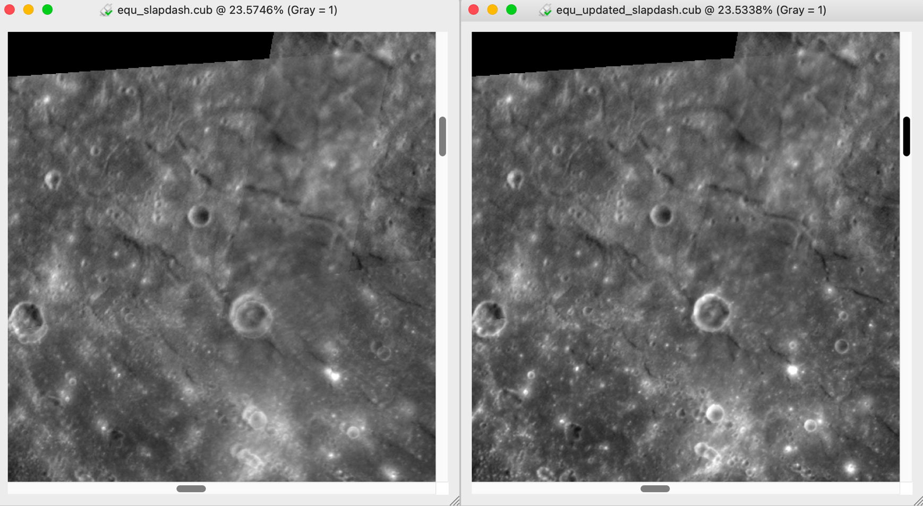
Worth it? Totally. qview equ*slapdash.cub

Slide 19
ISIS Photogrammetric Control Processes
Tammy L. Becker
Kris J. Becker
March 4, 2021

Slide 20

ISIS3 Controlled Map Product Development
Uncontrolled Mosaic
Images
Images
Controlled Mosaic
Ingested
RAW-
EDR
Images
SPICEINIT
(Level 0)
Radiometric
Calibration
(Level 1
or
Ingested CDR)
Map
Projection
(Level2)
cam2map
Shape Model:
-DEM
-Socet/Set DEM Product
Target Body:
-Ellipsoid/Sphere
Controlled Mosaic
Updated Image
Labels
Sphere
DEM/Radius
-LOLA
-MOLA
-Gaskell
C-Smithed Kernels
-new adjusted SPICE
Mosaic
automos
Build Control Point Network
Jigsaw: Bundle Adjustment
Solution, Accuracy,
Error and Analysis
Expanded On Next Slide
20

Slide 21
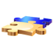
CnetEditor
Interactive Sort
Filter, Modify
Network
ISIS3 Photogrammetry
Initial Control Net
Path 1 – by image overlap
QMOS
Display
Footprints
findimgoverlaps
overlapstats
Statistics/data of
footprint
information
CnetSplit
Separate Single
Network
into multiple
Autoregtemplate
Create co-reg
PVL file or QNET
PVL file editor
“Ground”
Sources
“Add/Edit “
Constraint
Sigmas into
Network
Digital Image
BaseMap
camstats
attach=True
footprintinit
AutoSeed
CnetMerge
Merge Separate
Networks into a
Single Network
Pointreg
Measurement
Coregistration
CnetRef
Establish
Reference Images
for each Point
Digital
Elevation
Model
Data Prep; know your data
QNET
Spiceinit
Apriori
NAIF/
SPICE
CnetExtract
Create a
Sub-Network
from a Main
Images
Images
CnetWinnow
Clean
Network of
Blunders
Target
Body
Ellipsoid/
Sphere
Images
CnetEdit
Modify
Network
CnetCheck
Network Quality
Control
Shape
Model
(DEM)
Initial Control Net
Path 2 – by grid spacing
Jigsaw
CnetHist
CnetNewRadii
Update Radius
values
in Network
CnetAdd
Add image
measures
CnetBin2PVL
Convert Binary
Network to PVL
format
SeedGrid
Establish Lat/Lon
Increment
CnetTable
Campt information
Based on network
Points and Msrs
Jigsaw Reports
Output
Network
CnetDiff
Difference
Network Files
Updated
Images
Labels
Other
“NetWork”
Sources in PVL format
NASA/AMES
Network
CnetStats
Stats on network
Images, Points,
Msrs
QMOS
Display
Network
Points
SocetSet
Points +Msmts
(with Ground)
Mat2Cnet
Isis2toIsis3
CKwriter
Generate
C-smithed
Camera kernel
SPKwriter
Generate
C-smithed
Spacecraft-kernel

Slide 22
Initiating a control network involves a choice of two paths
FIRST: Know your data!
camstats
camera statistics for a single image or all images
attach=true for qmos
Increase linc & sinc to 10 to 100 the default = 1 (slow)
footprintinit - create polygons from images for qmos
qmos - overlaps and basic camera statistics
qview - image quality, pointing quality, overlap amounts
mosrange - latitude/longitude, resolution range for all images in map file format
caminfo - good for a large amount of images. camera statistics, geometry information, DN statistics,
label and polygon information (in WKT format) for a single image or all images
Familiarity with your data regarding…
1) how the images overlap
2) range of resolution
3) viewing & illumination conditions
will help determine the best path for establishing your network…
by image overlaps (path1) and/or
by a gridded control point distribution (path2)
*There is no right or wrong method, there could be a combination of the paths

Slide 23
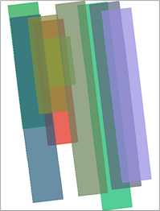
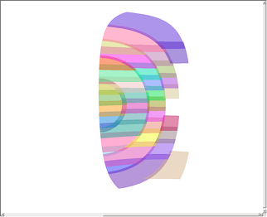
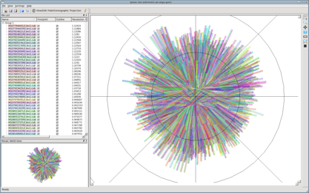
Initiating a control network involves a choice of two paths
CTX Footprints
Candidate for either path
Messenger Flyby Footprints:
Candidate for autoseed path
LROC NAC Polar Footprints
Candidate for seedgrid path

Slide 24
Starting a Control Network from scratch with Image Overlaps v.s. Gridded Points
The initial goal is to have a sufficient distribution of control point image measures across and through the image overlaps and across your images where possible
findimageoverlaps
autoseed – based on your image overlaps
seedgrid – doesn’t know a thing about your images, only the lat/lon/spacing
qmos-footprint display
qmos-footprint display

Slide 25
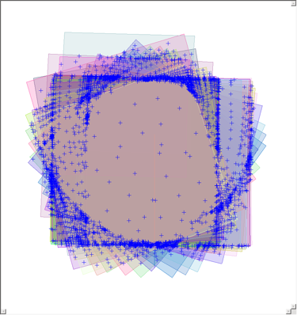
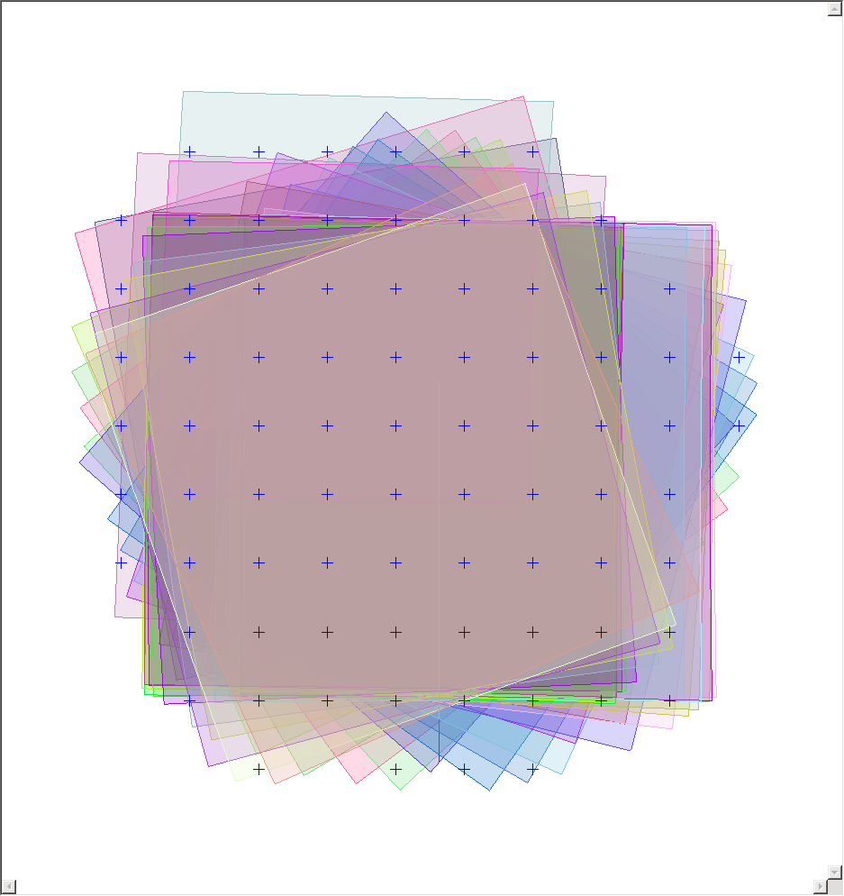
findimageoverlaps
autoseed
*Has the potential to see every single overlap polygon
seedgrid map=spolar_projection.map
cnetadd retrieval=point extract=modified
*Every image in the stack needs a good distribution

Slide 26

X/Y Spacing starting point
Determined by resolution(s), overlap area(s) and desired number of points in overlaps
Try to strike a balance with the number of points seeded
Too many points
Increases program runtime
Increases potential number of registration false positives
Too few points
May result in poorly connected the data
May result in more manual point picking than desired
seedgrid
with moderate X/Y Spacing
seedgrid
with less dense X/Y Spacing

Slide 27
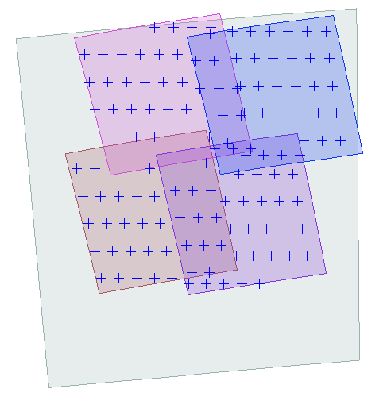
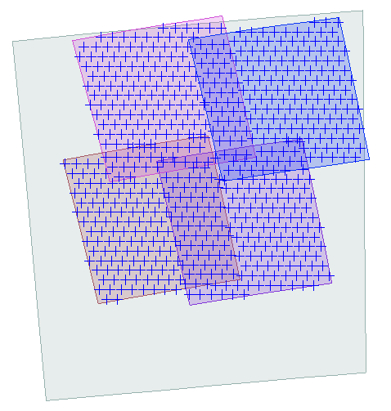
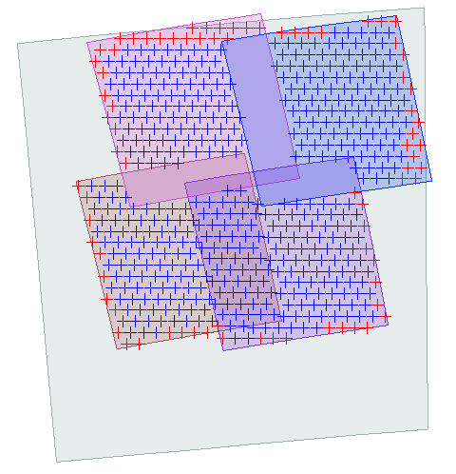
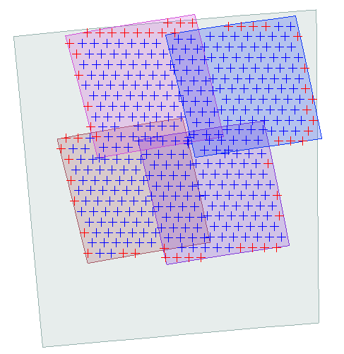
findimageoverlaps
autoseed – based on your image overlaps
Spacing too sparse for small overlaps
Spacing a little too dense maybe?
::::::::::::::
grid.def
::::::::::::::
Group = PolygonSeederAlgorithm
Name = Grid
MinimumThickness = 0.1
MinimumArea = 56000
XSpacing = 15000 #40000
YSpacing = 15000 #40000
End_Group
Minimum Area Too Thick
Just right
::::::::::::::
grid.def
::::::::::::::
Group = PolygonSeederAlgorithm
Name = Grid
MinimumThickness = 0.3
MinimumArea = 56000
XSpacing = 25000
YSpacing = 25000
PixelsFromEdge = 35
End_Group

Slide 28
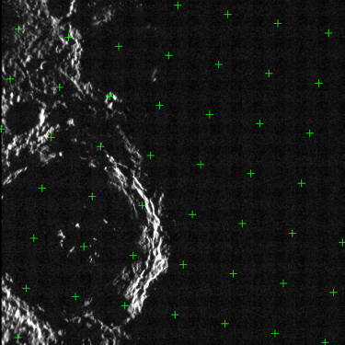
Avoiding undesirable data (shadows, limb, terminator, edges, no data, etc.)
Use valid measure deffile and desired settings
$ISIS3DATA/base/templates/cnet_validmeasure/validmeasure.def
Can be applied anytime in an application that offers a ‘deffile’ parameter
cnetedit deffile=valid.def
findimageoverlaps/autoseed: autoseed deffile=valid.def
seedgrid/cnetadd: cnetadd deffile=valid.def
Avoid control point image measures in the shadows with a MinDN and or a maximum incidence angle (MaxIncidence) for the terminator region
Group = ValidMeasure
MinDN = 0.001
MaxDN = double
MinEmission = double (limb/oblique criteria)
MaxEmission = double
MinIncidence = double (terminator/shadow)
MaxIncidence = 75 (degrees)
MinResolution = double
MaxResolution = double
PixelsFromEdge = integer OR MetersFromEdge = double
EndGroup

Slide 29
Avoiding undesirable data (shadows, limb, terminator, edges, no data, etc.)
Use valid measure deffile and desired settings $ISIS3DATA/base/templates/cnet_validmeasure/validmeasure.def
Can be applied anytime in an application that offers a ‘deffile’ parameter
cnetedit deffile=valid.def
findimageoverlaps/autoseed: autoseed deffile=valid.def
seedgrid/cnetadd: cnetadd deffile=valid.def
Avoid control point image measures in the shadows with a MinDN and along the edges of the image with PixelsFromEdge
Green “+” = Valid Measures; Yellow “+” = Invalid Measures (Ignore = True)
Group = ValidMeasure
MinDN = 1.5
MaxDN = double
MinEmission = double (limb/oblique criteria)
MaxEmission = double
MinIncidence = double (terminator/shadow)
MaxIncidence = double
MinResolution = double
MaxResolution = double
PixelsFromEdge = 20
EndGroup

Slide 30
Spiceinit
Apriori
NAIF/
SPICE
Images
Path1: Starting a Control Network from scratch using Image Overlaps
Images
footprintinit: Create footprint polygons for each image
Provides footprint polygons for qmos
Required for findimageoverlaps & autoseed
Set maxemission and maxincidence for limb and terminator data
Consider a smaller linc and sinc for limb, polar or irregularly shaped data
Set increaseprecision=true for automatic adjustment with linc and sinc to smaller values if current values result in invalid polygons
findimageoverlaps: Create a binary file of overlapping polygons
overlapstats: Compute overlap polygon statistics
Input file is the findimageoverlaps output
View output of overlapstats for help with setting initial parameter values in the autoseed ‘deffile’
autoseed: Create a distribution of control points across the areas of overlap
autoseed Workshop!!
http://isis.astrogeology.usgs.gov/IsisWorkshop/index.php/Autoseed
autoseed deffile templates
cp $ISIS3DATA/base/templates/autoseed/grid.def mygrid.def
Set optional ‘valid measure’ parameters within the autoseed deffiile (mygrid.def)
$ISIS3DATA/base/templates/autoseed/gridExtraKeywords.pvl
Examples-avoid the edges of an image, high emission angles, shadows
Commands:
> footprintinit from= linc= sinc= maxema= maxinc= (use –batchlist)
> findimageoverlaps fromlist= overlaplist=overlap.dat
> overlapstats fromlist= overlaplist=overlap.dat to=overlap.csv
> autoseed fromlist= overlaplist=overlap.dat deffile=mygrid.def onet=autoseed.net pointid=“prefix_???”
qnet - Load the image list and autoseed.net file; view some number of cubes to evaluate the control point distribution in Level1 (raw camera space)
qmos - Overlay the output autoseed.net file on top of the image footprints to evaluate control point distribution
Images
calibrated/
clean
Data Prep & know your data
footprintinit
camstats
attach=true
overlapstats
qmos
findimgoverlaps
autoseed
Optimize a point distribution in overlaps with autoseed
Visualize the results in both qmos and qnet
QNET

Slide 31
Spiceinit
Apriori
NAIF/
SPICE
Images
Path2: Starting a Control Network from Scratch Using Gridded Points
Images
footprintinit: Create footprint polygons for each image (for qmos)
seedgrid: Create a distribution of control points across the areas of overlap
Establish grid by XY meters or latitude/longitude increment (spacing parameter)
Note how many control points are created!!
See Autoseed Worshop for tips on setting spacing
http://isis.astrogeology.usgs.gov/IsisWorkshop/index.php/Autoseed
Create a ‘valid measure’ parameter file
Possible parameters for valid criteria with an image measure are listed in
$ISIS3DATA/base/templates/cnet_validmeasure/validmeasure.def.example
Create your own parameter file to edit
cp $ISIS3DATA/base/templates/cnet_validmeasure/validmeasure.def.example validmsr.def
Edit the validmsr.def to establish optional criteria
Examples-avoid the edges of an image, high emission angles, shadows
cnetadd: Add the image measures
Based on who overlaps the control point lat/lon’s created in seedgrid
Supply the valid measure criteria parameter file (deffile)
Any measure added to a control point considered invalid will have Ignore=True
cnetedit: Delete the ‘Ignored’ points from the network
NOTE: future application cnetref might fail if this step is elminated
Potential problem with control points that contain no image measures (no one overlaps that point)
Commands:
> footprintinit from= linc= sinc= maxema= maxinc= (use –batchlist)
> seedgrid target= minlat= maxlat= minlon= maxlon= spacing= desc= pointid=“prefix_???”
> cnetadd fromlist= deffile=validmsr.def retrieval=point onet=cnetadd.net polygon=true
extract=modified
>cnetedit cnet=cnetadd.net onet=cnetadd-edt.net
>qnet - Load the image list and cnetadd-edt.net file; view a number of cubes to evaluate the control point distribution in Level1 (raw camera space)
>qmos - Overlay the output cnetadd-edt.net file on top of the image footprints to evaluate control point distribution
Images
calibrated/
clean
Data Prep & know your data
footprintinit
seedgrid
camstats
attach=true
qmos
cnetadd
cnetedit
Visualize the results in both qmos (for footprint overlap view) and qnet (for Level1 view)
QNET

Slide 32
Images
Processing the Control Network
Spiceinit
Apriori
NAIF/
SPICE
Images
Images
calibrated/
clean
The next goal is to maximize the success and accuracy results of the sub-pixel registration amongst the image measures within each tie-point.
cnetref: Establish the reference images for each control point (Optional-Use with Caution)!
The measure (image) within a control point with Reference=True becomes the “pattern” chip in pointreg for the remaining measures
The Reference measure is implicitly defaulted to the 1st measure encountered within a control point
unless it is overridden interactively in qnet or cnetref
cnetref will assign the image measure with Reference=True by a selection of criteria
Criteria=emission (avoid the limb; the image measure with the lowest ema = reference)
Criteria=incidence (avoid the terminator; the measure with the lowest inc=reference)
Criteria = resolution (multiple criteria choices available to select the reference)
Can use the same valid measure parameter file that is passed to cnetadd or …create/edit
cp $ISIS3DATA/base/templates/cnetref/no_operator.def.example validmsr.def
Criteria=interest ( “nudge” the control point locations to new coordinates in areas of interest)
cp $ISIS3DATA/base/templates/cnetref/standard_deviation_operator.def.example std.def
pointreg: Pattern matching amongst the measures within each control point
Subpixel registration matches the measures to the reference image
Autoreg deffile template (create your own and edit)
cp $ISIS3DATA/base/templates/autoreg/coreg.maxcor.p2020.s5050.def reg.def
Pattern Match Workshop and Document
http://isis.astrogeology.usgs.gov/documents/PatternMatch/PatternMatch.html
http://isis.astrogeology.usgs.gov/IsisWorkshop/index.php/Automatic_Registration
cnetedit: Delete the ‘Ignored’ measures and points
cnetcheck: Used to double check the quality of the network right before jigsaw
qnet: Used through the entire process for visual and manual adjustments
jigsaw: Least squares bundle adjustment-default is to solve for camera angles & twist
Commands:
> cnetref fromlist= cnet= onet=cnetref.net deffile= criteria= type=
> pointreg fromlist= cnet=cnetref.net onet=pointreg.net deffile=reg.def points=all measures=all
>cnetedit cnet=pointreg.net onet=pointreg-edt.net
>cnetcheck fromlist= cnet=pointreg-edt.net prefix=pointreg-edt-CHK
> jigsaw fromlist= cnet=pointreg-edt.net onet=jig.net file-prefix=jig
seedgrid
cnetadd
autoseed
cnetedit
Processing the Control Network
cnetref
Change Pt/msmt
Location and/or
establish reference
image
QNET
Cnet Utilities
cnetstats
cnetedit
cneteditor
cnetsplit
cnetmerge
pointreg
Measurement
Coregistration
cnetcheck
Network
Quality Control
Jigsaw

Slide 33
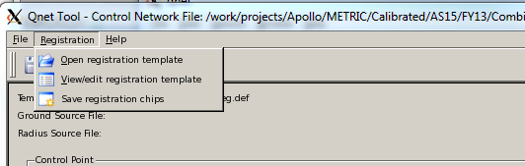
Pattern Matching the Image Measures
Use qnet to
Define the autoreg parameter file (deffile)
View registration ‘chips’ to iterate and optimize the parameters for automated success
Refer to: http://isis.astrogeology.usgs.gov/IsisWorkshop/uploads/8/80/Qnet_demo.pdf
Pattern Chip
The more ‘bland’ the data is, the larger the Pattern Chip box should be
Search Chip
Should always be larger than Pattern chip
The size needs to account for feature offset (misregistration)
SearchChipSize = PatternChipSize + (OffsetPixelEstimate * 2)
It should be unnecessarily large for the Pattern Chip to avoid a ‘false positive’ match

Slide 34
Pattern Matching the Image Measures
Dimensions
The overall shape of Search and Pattern chips should mimic your image data and how it overlaps where possible
Long and skinny images and overlaps, then try long and skinny Pattern and Search chip size dimensions
Fit Chip
Will match the dimension of the Search Chip
Filled with the resulting Goodness of Fit values at every position that the Pattern Chip has been walked across the Search Chip computing a fit correlation value
The Fit chip is only good to a maximum of ONE pixel accuracy
Strategize with complex datasets
More than one registration definition file may be necessary to register all measures and points
1st time: pointreg cnet=in.net onet=out-1.net deffile=reg-1.def points=all measures=all
2nd time: pointreg cnet=out-1.net onet=out-2.net deffile=reg-2.def points=all measures=candidates

Slide 35
Pattern Chip
25 samples x 25 lines
The Pattern Chip is a sub-area extracted from the Reference image measure within a control point. The center of the chip is the coordinate sample and line
Search Chip
90 samples x 90 lines
Fit Chip
90 samples x 90 lines
Line 13
(25/2)
NULLs
Pattern Chip
25 samples
x 25 lines
Sample 13
(25/2)
NULLs
NULLs
NULLs
The Fit Chip is filled with the resulting
Goodness of Fit (correlation value) value at every position that the Pattern Chip has been walked across the Search Chip

Slide 36
Pattern Chip
25 samples x 25 lines
Search Chip
90 samples x 90 lines
Fit Chip
90 samples x 90 lines
The sample, line coordinate of the highest value within the Fit Chip is used to compute the Adjusted Registered sample, line coordinate of the image measure.
The Fit Chip is filled with the resulting
Goodness of Fit (correlation value) value at every position that the Pattern Chip has been walked across the Search Chip

Slide 37
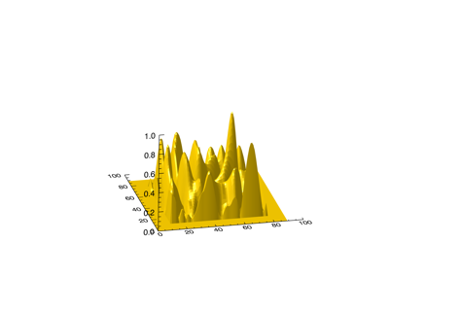
Fit Chip – 3D
90 samples x 90 lines
If SubPixelAccuracy = True (default), the Fit Chip is then passed onto a centroid surface modeling algorithm in order to refine the whole pixel registered sample, line coordinate to a sub-pixel accuracy
For more details refer to:
http://isis.astrogeology.usgs.gov/documents/PatternMatch/PatternMatch.html#SubPixelAccuracy

Slide 38
Quality Control of a Network
Before running jigsaw, the completeness and “health” of the input control network should be double checked
-cnetcheck creates output files indicating network issues
-The reported issues need to be addressed before running jigsaw
-Most common issues
Avoid single measures in a point (only one image in a control point)
Optimum is more than 3 images/point at varying viewing angles to support convergence
Avoid more than 1 “island”, if all images are tied together then a single island is reported
Make sure each image contains greater than 3 or 5 control points
Low coverage report (convex hull) indicates the distribution of the points across the image
Control Point Distribution Across an Image
Good distribution
Convex Hull = ~0.99
Bad distribution
Convex Hull < 0.5
Bad distribution
Convex Hull < 0.5
The point measurement distribution across the area of the image is critical for both frame cameras and line scan cameras. Think of the measurements as anchor ties.
In addition, the distribution of the points in the context across the overlapping areas of the images is also important and should be thought of as anchor ties (tacks) through the ‘stack’ of images

Slide 39
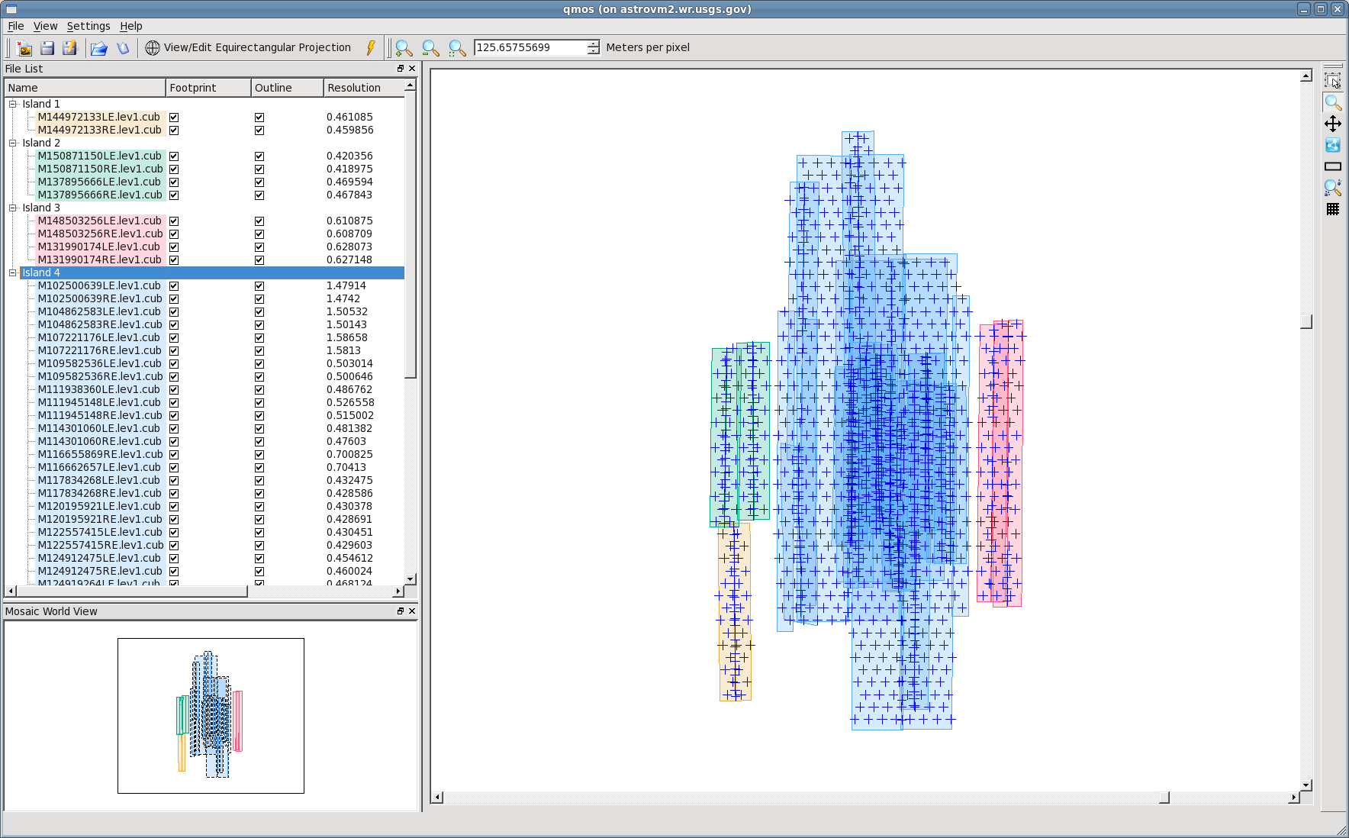
Example of control network “Islands”
Qmos:
Image footprints with a single control network overlaid
-disconnected islands
Island 4
Island 2
Island 3
Island 1
The blue “+” marks above are the control points overlaid on top of the image footprints by latitude and longitude position.
This is a single control net file and simply demonstrates what are considered islands where the images do not overlap.
Also, even though the images in Island1 overlap slightly with the images in Island2, qmos has indicated that these images do not share a control point

Slide 40
Control Network Terminology (very, very brief for now)
Control Point Type
Free (no constraints) – also referred to as “tie-points”
Constrained (weighted to a ‘ground’) - also referred to as “ground-points”
Fixed (highest constraint possible to ‘ground’) - also referred to as “ground-points”
Apriori Latitude, Longitude, Radius
The location of the control point; a priori based on original SPICE
Computed by the first measure in the control point, or an average, or set when measured to a Ground reference (type=constrained or fixed)
Apriori Latitude, Longitude, Radius Sigmas
Parameters for weighing/constraining the location of the control point with type Contrained of or Fixed (set in qnet or cneteditor)
Adjusted Latitude, Longitude, Radius
The converged location of the control point after jigsaw
Ignore = True/False
If True, the control point and all measures are ignored by pointreg (optional) and jigsaw; cnetedit will remove these measures by default
Measurement The sample and line pixel coordinate of an image
Serial Number A unique identifier for every image constructed “on-the-fly” in the cnet applications using the instrument group keyword values. Internal to the control network; most applications will include the associated filename. To view a Serial Number run ‘getsn from=image.cub’
Sample, Line The image pixel coordinate
Measurement Type
Candidate: least accurate pixel measurement-usually based on apriori SPICE
Manual: measured manually in qnet
RegisteredSubPixel: output coordinate resulting from pointreg, or qnet-”Register” feature
Ignore = True/False (Measure)
If True, the measurement will be ignored by pointreg (optional) and jigsaw; cnetedit will remove these measures by default
Reference=True (Measure)
The image that is used as the ‘Pattern’ chip for the pattern matching of all remaining measures (image coordinates) within a control point
The 1st measure listed within a control point is implicitly set as Reference=true by most applications
*This can be overridden by the ‘cnetref’ application or interactively by the user within qnet (always the left hand image in the control point editor)
Will often remain measurement-type=candidate after pointreg
Goodness of Fit (Measure)
The pattern match correlation result for co-registration of measures to the reference
Sample/Line Residual (Measure)
Jigsaw residuals in pixels

Slide 41
Control Network Schema
(Abbreviated Version)
Contol Point Id 100
Type=Free, Constrained, Fixed
Apriori Latitude=
Apriori Longitude=
Apriori Radius=
Ignore=False/True
Measurement 1
Serial Number=AA
MeasureType=Candidate, Sub-Pixel, Manual
Reference=True
Sample=
Line=
Ignore=False/True
Control Point Id 200
Type=Free, Constrained, Fixed
Apriori Latitude=
Apriori Longitude=
Apriori Radius=
Ignore=False/True
Measurment 1
Serial Number=AA
MeasureType=Candidate, Sub-Pixel,Manual
Reference=False
Sample=
Line=
Ignore=False/True
Measurement 2
Serial Number=BB
MeasureType=Candidate,Sub-Pixel,Manual
Reference=True
Sample=
Line=
Ignore=False/True
Measurement 3
Serial Number=CC
MeasureType=Candidate,Sub-Pixel,Manual
Reference=False
Sample=
Line=
Ignore=False/True
Measurement 2
Serial Number=DD
MeasureType=Candidaet,Sub-Pixel,Manual
Reference=False
Sample=
Line=
Ignore=False/True
Control Point 200-Measure 1
Serial Number: AA
Control Point 100-Measure 1
Serial Number: AA
Image-XA.cub
Control Point 100-Measure 2
Serial Number: DD
Image-XD.cub
Control Point 200-Measure 2
Serial Number: BB
Image-XB.cub
Control Point 100-Measure 3
Serial Number: CC
Image-XC.cub
Control Point Type
Free (no constraints) – also referred to as “tie-points” or “match-points”
Constrained (weighted to a ‘ground’) - also referred to as “ground-points”
Fixed (highest constraint possible to ‘ground’) - also referred to as “ground-points”

Slide 42
Control (Ground) Points
Type=Constrained or Fixed
Control Point or Ground Point
Represents a known location on the ground (latitude/longitude/radius)
Sigma values or weights are assigned to each Control Point (indication of how accurate)
Example known ‘Ground’ sources
For radius/topography values at a location
LOLA for Moon, MOLA for Mars, Gaskell DEM for Vesta
For ‘horizontal’ latitude and longitude location values
DEMs
Basemaps
Distribution
Control points need to be distributed across the ground coverage extents of the images
Control points need to distributed across/within the overlaps of the images
Refer to: http://isis.astrogeology.usgs.gov/IsisWorkshop/uploads/8/80/Qnet_demo.pdf

Slide 43
Control (Ground) Points
Type=Constrained or Fixed
Vesta – Gaskell DEM
Equirectangular
Shaded version
Pink marks indicate “ground” control point locations
This example is somewhat sparse
Vesta – DAWN Image Overlaps
Equirectangular
Shaded version
Green marks indicate “ground” control points
Areas where additional
control points should be
collected

